Slide 1
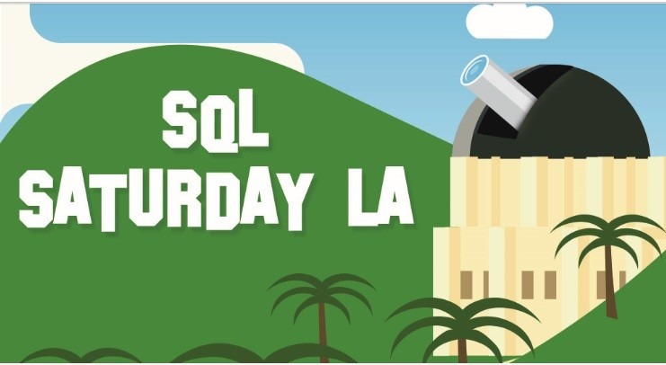
On-Premises or Hybrid Cloud?
Virtualizing SQL Server on vSphere
Dèjì Akọ́mọláfẹ́
Staff Solutions Architect
Global Microsoft Applications Practice Lead
June 12, 2021

Slide 2

Agenda
We’ve come a long way: Questions we no longer ask
Embracing the NOW: Questions worth asking
Getting from Here to There: Questions you now have
The Guideposts: References and Collaterals
Thank You

Slide 3
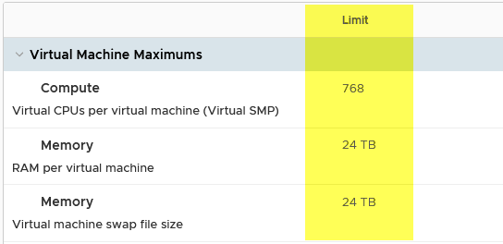





Questions we no longer ask
Platform Reliability/Availability
Platform Security
Performance
Return on Investment
Application Integrity
Physical or Virtual?
Applications don’t discriminate
Is Virtualization stable enough for my IMPORTANT Mission-Critical Applications?
Well…duh
Is Virtualization Secure?
Not any less secure than Physical
Stolen VMDK? VM Encryption
Can Virtualization handle Bazzillion IOPS?
TCO, ROI, Penny-pinching…
Virtualization improves consolidation, density, elasticity, and utilization.

Slide 4


“The Cloud” is A Destination For SQL Server Workloads
…How Do You Get There?
The Question is…
…What Would It Look Like?
…How Do You Make it Work?
For You…

Slide 5
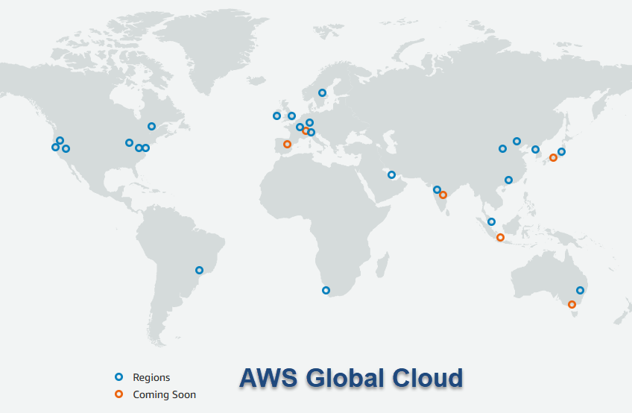
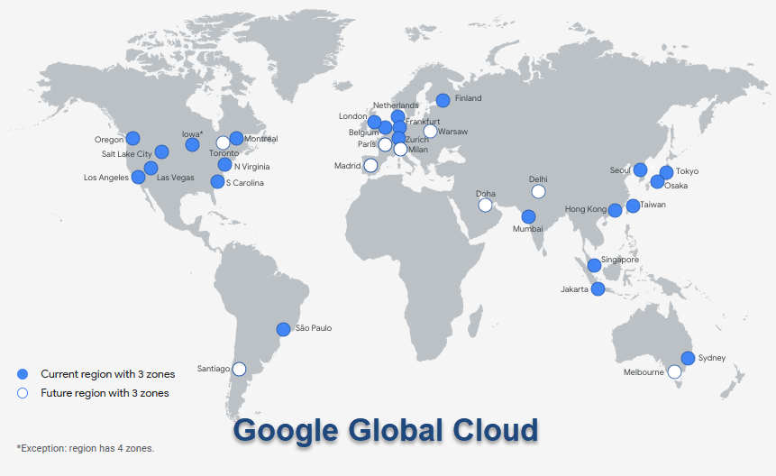
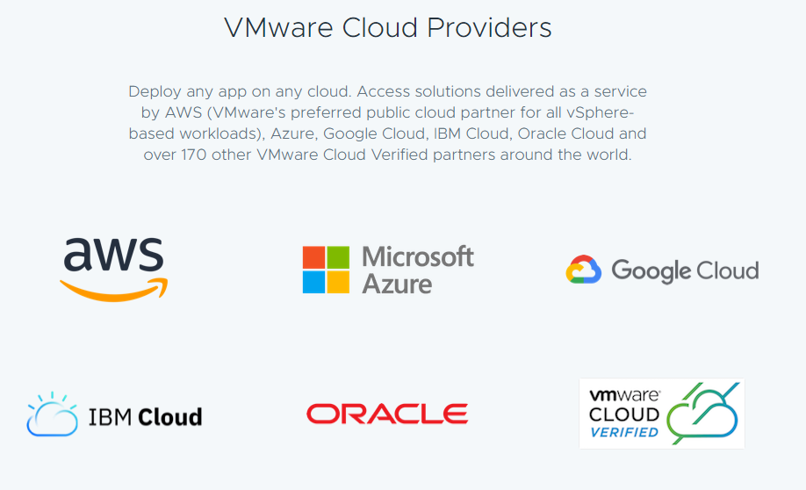
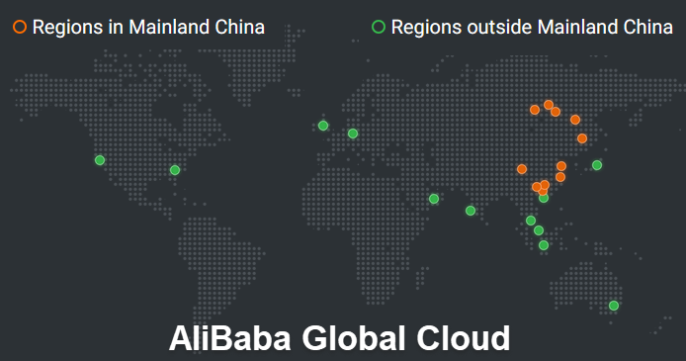
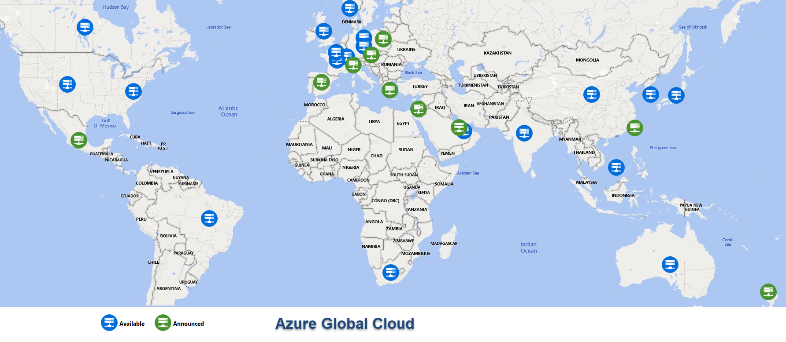
It’s EVERYWHERE
VMware Cloud
It’s ANYWHERE

Slide 6






VMware Cloud on Partners DataCenter Infrastructure
Rapidly Extend to the Cloud
VMware environment with global Partner footprint, reach, availability
Operational Consistency
Extend on-premises investments in tools, skills and processes to the cloud
Access Partners (AWS, Azure, IBM, Google, AliBaba, etc) Native Services
Expand the value of existing applications
Private Cloud
Public Cloud
VMware Cloud Infrastructure
VMware Cloud Providers
Partner Services
VMware Cloud Infrastructure
vCenter
vCenter
…
Compute
Storage
Network
Compute
Storage
Network
Customer Datacenter
VMware Cloud Global Partner Infrastructure

Slide 7
The Elephant in The Cloud: Licensing / Supportability
No changes to your on-premises licensing agreements
No SA (Software Assurance) requirement (but recommended)
Fully supported to run in a virtual environment
No limitations/special certification for VMware Cloud on AWS
Licensing
Supportability

Slide 8
The Elephant in The Cloud: Licensing Guidelines – (AWS)
Considerations for licensing Windows Server on VMware Cloud on AWS
Customer Scenario | Windows Server license date* | Customer options
Customer owns licenses to Microsoft Windows Server 2019 or previous versions and wants to move to VMware Cloud on AWS. | Before Oct 1, 2019 | Customer can leverage existing licenses (Bringing Your Own Licenses (BYOL). Check this document for more details.
Customer acquires Microsoft Windows Server licenses and wants to move to VMware Cloud on AWS; OR customer does not have any Windows Server licenses and wants to have them on VMware Cloud on AWS hosts. | On/After Oct 1, 2019 | Customer must purchase new Windows Server licenses through VMware under VMware and Microsoft SPLA. See the explanation below.

Slide 9
The Elephant in The Cloud: Licensing Guidelines – (AWS)
Considerations for licensing Microsoft SQL Server on VMware Cloud on AWS
Customer Scenario | Microsoft SQL Server license date* | Customer options
Customer owns licenses to Microsoft SQL Server 2017 or previous versions (with or without Software Assurance) and want to move to VMware Cloud on AWS. | Before Oct 1, 2019 | Customer can leverage existing licenses via BYOL. Check this document for more details.
Customer acquires Microsoft SQL Server licenses and want to move to VMware Cloud on AWS; OR customer does not have SQL Server licenses and wants to have them on VMware Cloud on AWS hosts. | On/After Oct 1, 2019 | Customer can purchase new licenses to Microsoft SQL Server through VMware under VMware and Microsoft SPLA.
Customer acquires Microsoft SQL Server licenses and wants to move to VMware Cloud on AWS. | On/After Oct 1, 2019 | Customer can leverage existing licenses via BYOL using License Mobility through Software Assurance.

Slide 10
Database Workloads Migration to VMware Cloud on AWS. Overview

Slide 11
Application Workload Tiering
Tier 1
Tier 2
Tier 3
High Performance
High Availability
High Costs!
Capacity
Cost Savings
Consolidation
Overcommitment

Slide 12
Overview of SQL Server workloads
Tier 1
Tier 2
Tier 3
OLTP
High IOPS
TPC-E
SQL DSS/DW
High throughput
TPC-H
Backup / Restore / Database refresh
Sequential Read/Write nature

Slide 13
Migration Technologies Overview
User-initiated, single VM at a time
Leverages Long Distance/Cross vCenter vMotion
No scheduling possible
Should be used for “special” use cases: primary node of WSFC
Bulk Migration – based on vSphere Replication and require restart of a VM, multiplies VMs at a time
vMotion – based on vSphere vMotion. One VM at a time, VM will stay on-line
User-initiated or scheduled
Require network preparation, VPN configuration, provides L2 VLAN stretching
Live/Cold Migration
HCX

Slide 14
Microsoft SQL Server workloads on VMware Cloud on AWS

Slide 15
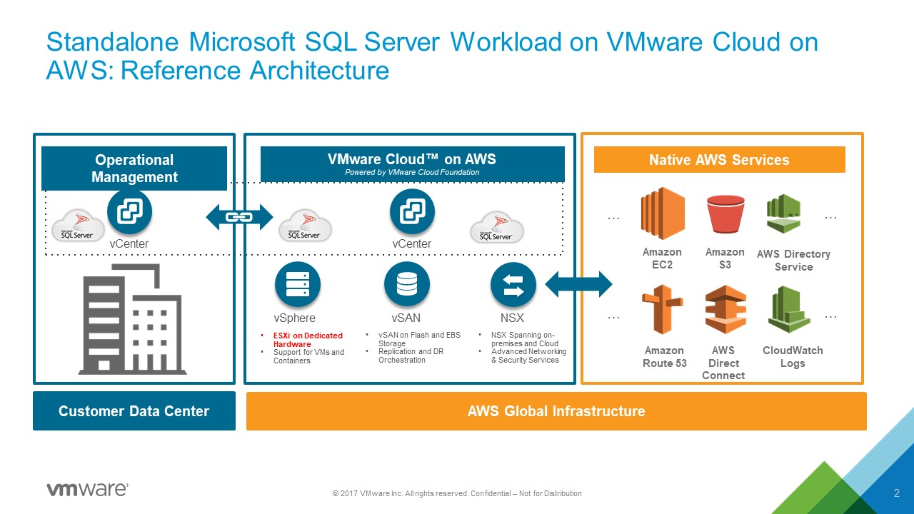

Slide 16

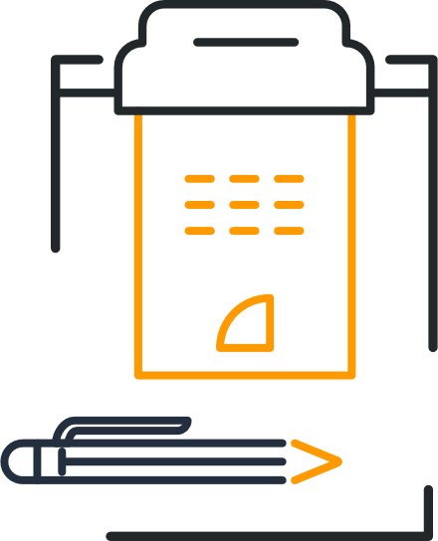



SQL Server workload migration
Good architecture and planning phase = successful migration
Rightsizing
Requirements
Risks
Assumptions
Constraints
High Level Architecture
Logical Design
Operational Considerations
Notes:
For those customers that want to adopt cloud, cloud migration-data center evacuations is the top use-case – followed by DR/DC extension.

Slide 17
SQL Server on VMware Cloud on AWS: VM configuration
Disable “CPU hot plug”
Match vCPU’s Core/Socket topology with Host’s Core/Socket topology (vNUMA)
Check Reservations/Limits
OK to use hot plug
Set Reservations for memory
vCPU
Memory

Slide 18
SQL Server on VMware Cloud on AWS: VM configuration (cont’d)
VMXNET3 is HIGHLY recommended
Always Enable RSS on vNIC
Consider using L2VPN/HCX stretched based Port Groups
SPBM: RAID1 and at least one failure to tolerate
Use Multiple PVSCSI Controllers
Don’t forget PVSCSI Queue Depth
Multiple Disks (vmdk)
Do not use SCSI bus sharing set to “virtual”
Network
Storage

Slide 19
SQL Server workloads – High Availability Options
Native
VMware Cloud on AWS
SQL Server
Availability Groups
SQL Server
Failover Cluster
vSphere HA
Stretched Cluster – Multiple AZ
No support restrictions
No shared storage
Use SQL Server replication (sync/async)
May be combined between on-prem and VMware Cloud on AWS
Support for clustered disk resources (SCSI3-PR)
Supported on stretched Cluster
May be combined with AGs
Require vHardware set to v11
Require SCSI bus sharing set to Physical

Slide 20
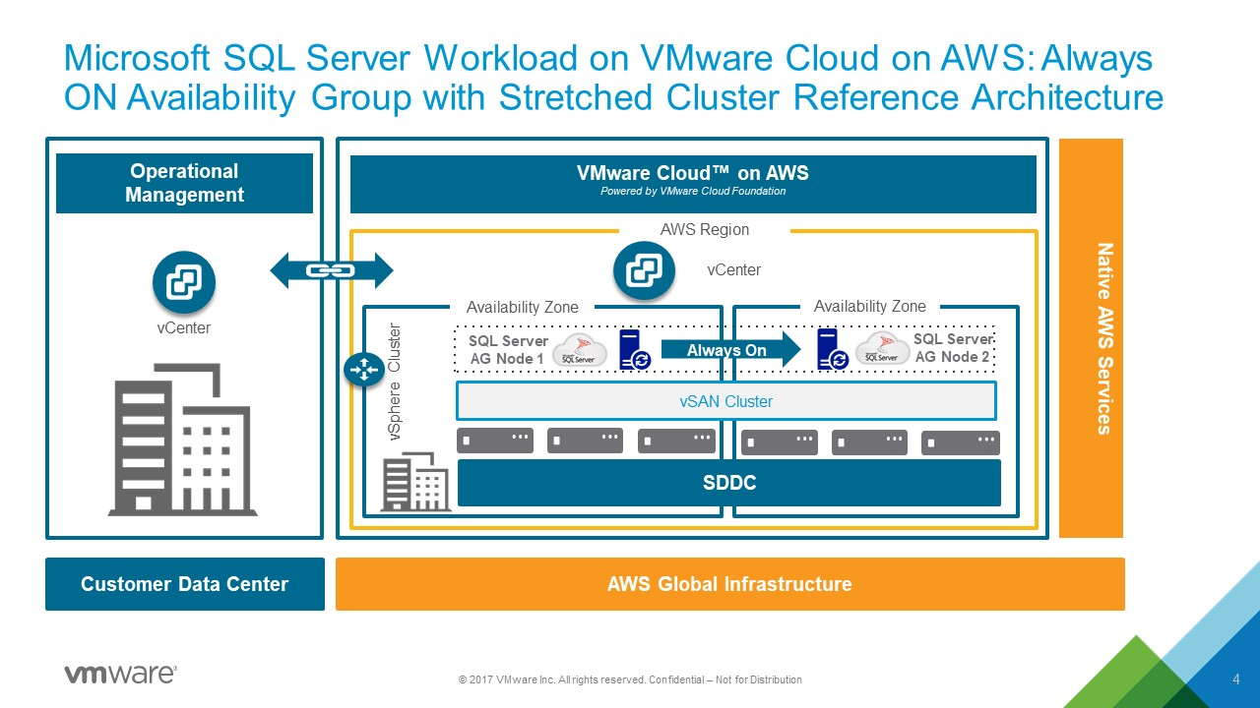

Slide 21
SQL Server on VMware Cloud on AWS: VM configuration (cont’d)
Check prerequisites (HLM, Networking)
Use Long-distance vMotion / HCX
Low loaded system – live vMotion
High loaded System – downtime / performance impact
Check all applications consuming databases
Check prerequisites (HLM, Networking)
Change database replication to asynchronous
Migrate secondary first
Failover to secondary
Migrate primary
Standalone SQL Server instance
SQL Server Always On

Slide 22
SQL Server Workload: Postmigration Configuration
Why is my application experiencing latency? Check that all applications using databases are migrated as well - vRNI
Configure VMware Cloud on AWS: Create Anti-Affinity Rules using Compute Policies
Configure Storage: ensure right SPBM are assigned
Configure VM: Check vNUMA (different hosts with different pNUMA)
Configure Database: Check Database Replication
Check the Best Practices Guide. Really. Please, do

Slide 23
References and Collaterals

Slide 24
Best Practices and Guidelines
Best Practices for Architecting Microsoft SQL Server on VMware vSphere® | https://www.vmware.com/content/dam/digitalmarketing/vmware/en/pdf/solutions/sql-server-on-vmware-best-practices-guide.pdf
Microsoft SQL High Availability Options | https://docs.vmware.com/en/VMware-Cloud-on-AWS/solutions/VMware-Cloud-on-AWS.919a954a9b6ca17cdc719ec42cda1401/GUID-1331586B63182F20ED706A5DD92A080D.html
Microsoft SQL Server Workloads and VMware Cloud on AWS: Design, Migration, and Configuration | http://www.vmw.re/sql-on-vmcaws
Microsoft SQL Server Scalability with VMware Cloud on AWS | https://cloud.vmware.com/community/2017/10/12/microsoft-sql-server-scalability-vmware-cloud-aws/
VMware KB: Guidelines for Microsoft Clustering on vSphere | https://kb.vmware.com/s/article/1037959

Slide 25
Licensing
Microsoft SPLA Licensing Release Update - VMware Cloud Community | https://cloud.vmware.com/community/2020/09/29/microsoft-spla-licensing-release-update/
Microsoft Licensing | FAQ | VMware Cloud | https://cloud.vmware.com/microsoft-licensing/faq#general
Licensing Microsoft Products (Windows Server and Microsoft SQL Server) on VMware Cloud on AWS – a New Paradigm | https://cloud.vmware.com/community/2020/02/10/licensing-microsoft-products-windows-server-microsoft-sql-server-vmware-cloud-aws-new-paradigm/
Licensing Microsoft SQL Server for VMware vSphere - Part One | https://blogs.vmware.com/apps/2020/07/licensing-microsoft-sql-server-for-vmware-vsphere-part-one.html
Licensing Microsoft SQL Server for VMware vSphere - Part Two | https://blogs.vmware.com/apps/2020/07/licensing-microsoft-sql-server-for-vmware-vsphere-part-two.html
Microsoft Azure VMware Solution – Eat Your Cake and Have it, too | https://blogs.vmware.com/apps/2020/12/microsoft-azure-vmware-solution-eat-your-cake-and-have-it-too.html

Slide 26
Microsoft Support for MS SQL Server Virtualization
Run programs on non-Microsoft hardware virtualization software - Windows Server | Microsoft Docs
https://docs.microsoft.com/en-US/troubleshoot/windows-server/virtualization/software-runs-on-non-microsoft-virtualization-software
“
...(F)or vendors with whom Microsoft has established a support relationship that covers virtualization solutions, or for vendors who have Server Virtualization Validation Program (SVVP) validated solutions, which may also have been awarded an Additional Qualification (AQ) for other functionality, Microsoft will support Windows Server operating systems subject to the Microsoft Support Lifecycle policy for its customers who have support agreements when the operating system runs virtualized on non-Microsoft hardware virtualization software. This support will include coordinating with the vendor to jointly investigate support issues. As part of the investigation, Microsoft may still require the issue to be reproduced independently from the non-Microsoft hardware virtualization software
”

Slide 27
Multiple Support Scenarios/Options
OEM/Cloud Reseller Support Contract
Public/Hybrid VMware Cloud Provider is PRIMARY Support Contact
Your On-Premises Support Contracts do NOT necessarily extend to your Public/Hybrid Cloud Workloads.
Ask your Vendor. Ask again.
If still unsure, ask Microsoft.
Because. It’s Microsoft SQL Server
Your Microsoft Premier Support Contract
VMware/Reseller Continues to be PRIMARY for On-Premises Support
Direct, Independent Cloud Consultants

Slide 28
All About VMware Cloud: https://cloud.vmware.com/
VMware BCA Team Blog: https://blogs.vmware.com/apps
VMware MS Apps Blog: https://blogs.vmware.com/apps/microsoft-resources
Explore More Sessions: https://vmwarelearningzone.vmware.com/

